Slide 1

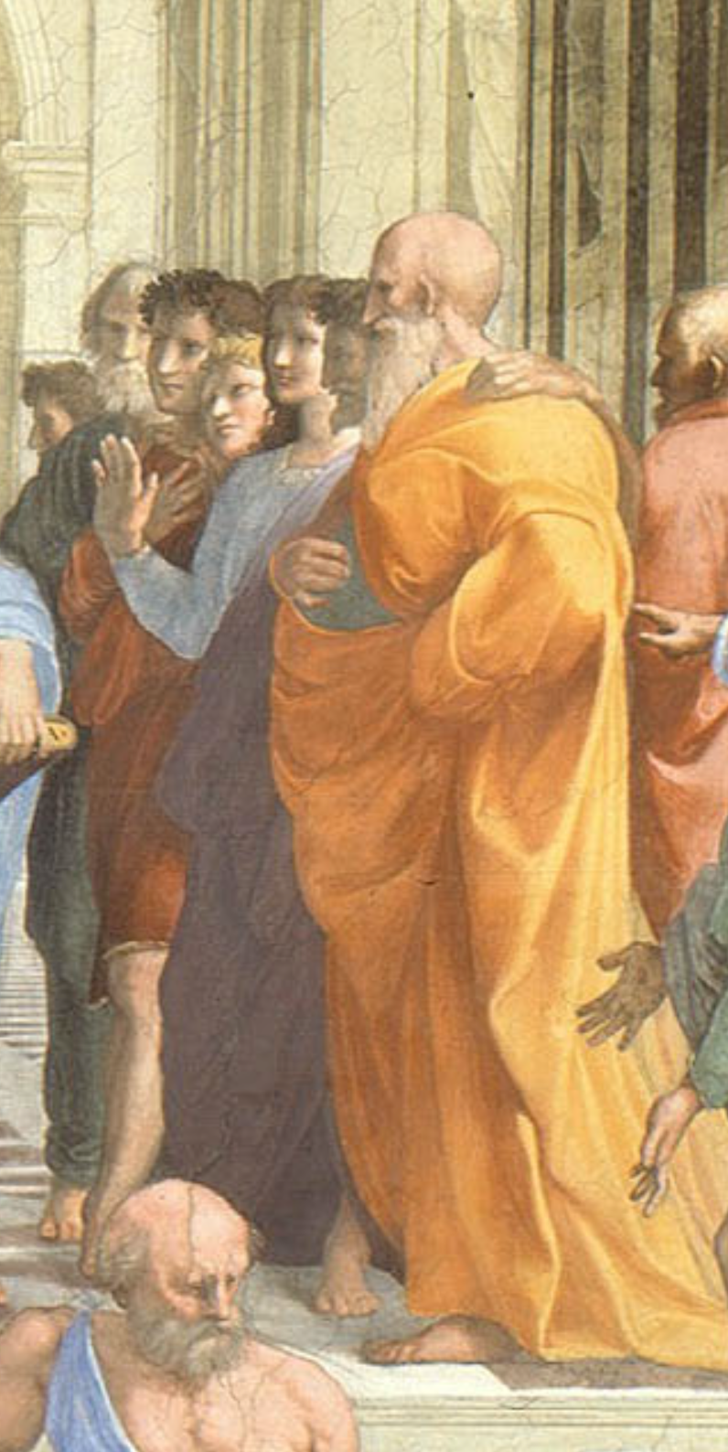

Lecture: Sokrates vs. Machiavelli on the Educational Process
Machiavelli:
I… put on the garments of court and palace… step inside the venerable courts of the ancients, where, solicitously received by them, I nourish myself on that food that alone is mine and for which I was born; where I am unashamed to converse with them and to question them about the motives for their actions, and they, out of their human kindness, answer me. And for four hours at a time I feel no boredom, I forget all my troubles, I do not dread poverty, and I am not terrified by death…
Sokrates:
The creations of the painter have the attitude of life, and yet if you ask them a question they preserve a solemn silence…. [Words] once written down they are tumbled about anywhere among those who may or may not understand them, and know not to whom they should reply, to whom not… and they cannot protect or defend themselves…. Would a husbandman… take the seeds… and in sober seriousness plant them during the heat of summer?… The serious pursuit of the dialectician… finding a congenial soul, by the help of science sows and plants therein words which are able to help themselves… and have in them a seed which others brought up in different soils render immortal, making the possessors of it happy to the utmost extent of human happiness…
3:00 of audio in this slide; 9:30 in this slide group
Notes:
On the slide are two substantial quotes about the experience and utility of reading books for education. One was written in the early 1500s by intellectual, bureaucrat, and statesman Niccolo Machiavelli of the republic of Florence, Italy. The other was written down in the early -300s by the philosopher Plato of the Republic of Athens, Greece, reporting or claiming to report the words of his teacher Sokrates. Pause this audio track, read the two quotations, and think about them.
Machiavelli, as portrayed by himself, and Sokrates, as portrayed by Plato, have diametrically opposed views of the usefulness of books. For Machiavelli, a book is almost as good as being there with the author—indeed, books are better, because Machiavelli in his library has many authors, all at his beck and call. Sokrates, by contrast, appears to think that books are very likely to be misread and misinterpreted: “they cannot defend themselves", "they do not know to whom they should reply, to whom not”.
For Sokrates, real education is only conducted by a teacher skilled in the art of dialectic—of getting a true dialogue going that leads the student to think for themself and thus have planted in their brain “words which are able to help themselves”, which will then “make the possessors… happy to the utmost extent of human happiness”.
Machiavelli, by contrast, thinks that education is accomplished by simply throwing somebody with leisure to read into a library.
For most people almost all of the time, for some people most of the time, and for all people at least some of the time, Sokrates was right: it is hard work to learn anything but the most partial and evanescent knowledge from books. That was the point of the Andy Matuschak reading—and I hope you got that point, although right now I am wondering if starting this course by asking you to learn something by reading an article was a smart thing for me to have done.
Andy Matuschak has ideas about how to reorganize and restructure books to make reading easier, or at least better from an educational point of view. And—his complaints about university courses that consist of badly taught lectures aside—I think it is fruitful to think of universities-as-institutions as scaffoldings and support systems to make deep and durable learning from books and other media easy, or easier, or at least possible: although you cannot lead a horse to water, you cannot make them drink if they do not want to.
We now face the problem of reproducing what makes a university work—what makes students at a well-functioning university more like Machiavellis and less like the hapless students of Sokrates, who are able to learn only through the deep, focused, personal attention of one of the greatest minds known to us in human history.
How are we going to manage to accomplish this?
——
Lecture: Sokrates vs. Machiavelli on the Educational Process
Machiavelli:
I… put on the garments of court and palace… step inside the venerable courts of the ancients, where, solicitously received by them, I nourish myself on that food that alone is mine and for which I was born; where I am unashamed to converse with them and to question them about the motives for their actions, and they, out of their human kindness, answer me. And for four hours at a time I feel no boredom, I forget all my troubles, I do not dread poverty, and I am not terrified by death…
Sokrates:
The creations of the painter have the attitude of life, and yet if you ask them a question they preserve a solemn silence…. [Words] once written down they are tumbled about anywhere among those who may or may not understand them, and know not to whom they should reply, to whom not… and they cannot protect or defend themselves…. Would a husbandman… take the seeds… and in sober seriousness plant them during the heat of summer?… The serious pursuit of the dialectician… finding a congenial soul, by the help of science sows and plants therein words which are able to help themselves… and have in them a seed which others brought up in different soils render immortal, making the possessors of it happy to the utmost extent of human happiness…

Slide 2

Our Difficult Task
How do we duplicate—online—the “active learning” components that the in-person university does as a matter of course?:
MOOCs did not cut it…
The people who could learn from MOOCs are the Machiavellis—the people who turn their books into sub-Turing class instantiations of the books’ authors, and have conversations with them
Thus a MOOC, for those who could learn effectively from it, was little better than and a lot more expensive than a book
We need a plan for those of you—which is most of us—who are not Machiavellis, but rather like Sokrates’s students
People who really need a tutorial…
A professor, a GSI, a roommate, a classmate, a study group…
2:45 audio
Notes:
How do we duplicate—online—the “active learning” components that the in-person university does largely as a matter of course, and that truly skilled readers like Machiavelli did whenever they entered into their libraries and thus began a dialogue with, say, the then-1500 years dead Roman historian Titus Livius?
About a decade ago there was great enthusiasm for MOOCs—massive open online courses—as a way that, as MOOC enthusiast Sebastian Thrum then put it, he could teach tens of thousands worldwide rather than mere hundreds at Stanford. B
ut MOOCs did not cut it.
It turned out, you see, that the people who could learn from MOOCs were the Machiavellis. There are people who can turn their books in front of their eyes into sub-Turing class instantiations of the books’ authors, and have deep conversations with them: “I am unashamed to converse with them and to question them about the motives for their actions, and they, out of their human kindness, answer…” said Machiavelli. Contrast Sokrates’s students, for whom the words on the page are like “the creations of the painter [which] have the attitude of life, and yet if you ask them a question they preserve a solemn silence…. You would imagine that they had intelligence”, but they do not.
MOOCs turned out to be very like books. For those who could learn effectively from them they were fine—but also little better than and a lot more expensive than a book. For those who could not actively read books to get deep and durable learning out of them, we found out that very few of them could “take” MOOCs and do much better.
Our problem here is that now the coronavirus is largely forcing us into MOOC-land, will-we, nill-we. And as much as we want to nill-we, I do not see how we can this fall. Yes, I firmly intend to hold class this fall in LeConte 4 Tu & Th 15:30-17:00 P[D|S]T. But I do not think that the public health authorities will let more than 20 out of 150 students into the room.
So we need a plan for those of you—which is almost all of us—who are not Machiavellis all, but rather much more like Sokrates’s student the hapless Glaukon. People who really need a tutorial—from a professor, a GSI, a roommate, a classmate, a study group, & c. In the university such tutorials are easy or at least straightforward to find or at least happen by accident with considerable frequency. But online?
We face a difficult task indeed.

Slide 3
Why Do Books “Reply” to Niccolo but Not to Sokrates?
Your professors are—often—not good guides:
We are genuinely world-class at this: if we were not, we would not be here, doing what we do…
We are very good at learning from books, curled up in a chair…
We are very good at sitting in front of a screen, issuing commands and looking at the numbers that come back, in order to try to grasp in our minds the multi-dimensional shape of a dataset…
And for us it is largely unconscious…
If this is going to work for you, you need to do consciously what we do largely unconsciously
Universities are good settings for that to happen
But at a university like Berkeley, the “active learning” component happens largely by accident, as a byproduct of the formal educational process of large classes, lectures, & exams
2:15 audio
Notes:
But how do we accomplish this task? First, we have to figure out what Machiavelli is doing—figure out why books “reply” to Niccolo but not to Sokrates’s student Glaukon. And here we—your professors—are—often—not going to be good guides.
We, you see, are genuinely world-class at what Machiavelli does. If we were not, we would not be here, doing what we do, holding the jobs we hold. We are very good at learning from books, curled up in a chair. We are very good at sitting in front of a screen, issuing commands and looking at the numbers that come back, in order to try to grasp in our minds the multi-dimensional shape of a dataset…
And the kicker is: for us this process is largely if not totally unconscious. We do it. But we do not think about what we are doing when we do it.
If this is going to work for you, you need to do consciously what we do largely unconsciously. Universities are good settings for that to happen. But at a university like Berkeley, the “active learning” component traditionally has happened largely by accident, as a byproduct of the formal educational process of large classes, lectures, & exams. We as a university are quite good at it: Berkeley’s high reputation as a place to go to university is deserved. But our success is much more the result of institutional evolution via natural selection and imitation than the result of conscious design based on an accurate analysis of how to do this.
We do know that “active” plays the major role: something you read once, twice, or even three times, but then do not do anything else with—your brain will take that information, decide that it is not important, and dump it with its connections in order to free up capacity for important things, like the wardrobes of the Kardashians or the technical specifications of imperial star destroyers.
So here, as we move this class online, we are going to require that you be active: that you talk, write, and think about the materials—rather than just sit passively listening, or even reviewing.

Slide 4

Read with Intent
If you just skim, say, Dasgupta: Economics: A Very Short Introduction:
You will then forget it—and you will have wasted an hour and a half
Our brains are very good at forgetting irrelevant information
And information we do not use and reuse is irrelevant
I want you to do what I do:
I am rarely just reading.
I am generally also analyzing, compressing, synthesizing, and summarizing.
I am taking notes—but very brief, synthesizing and summarizing notes.
And I am generally asking myself questions—and then answering them.
1:30 audio
Notes:
So: whenever you read, read with intent. If you just skim, say, Dasgupta: Economics: A Very Short Introduction, you will then forget it—and you will have wasted an hour and a half—for our brains are very good at forgetting irrelevant information, and information we do not use and reuse is classified as irrelevant
So I want you to do—consciously—what I do—largely unconsciously—when I read. When I read, I am very rarely just “reading”. I am generally also analyzing, compressing, synthesizing, and summarizing. I am thinking: that passage reminded me of something, and I am then turning away to find what it reminded me of, using the internet to refresh my recollection. I am constantly checking sources and references—that I can now do that is the glory of the internet, and I make maximum use of it. Is this author property quoting that one? What is the real context of that quotation? Did the first author intend the second author to take it that way—and even if that wasn’t the intended meaning, is it a valid meaning?
I find that I am always taking notes—but very brief, synthesizing and summarizing notes.
And I am generally asking myself questions—and then answering them—with respect to what the readings mean.
We are going to make you write, ask, answer questions, reflect, and discuss. And we are going to do so by making the typical week of this class a complicated and activity-filled chain of episodes.

Slide 5
Lecture: Activity Flow for a Typical Course Module
watch:
introductory
video
read:
prefatory
reading notes
read:
assigned
readings
quiz:
readings
comprehension
do:
jupyter notebook
problem set
participate:
60 min zoom
q&a session
watch & listen:
slides with
audio
discuss:
(asynchronously)
readings
(asynchronously)
reflect & discuss
the module
breakout:
30 min 8 person
zoom section
discussion
provide
feedback
to teachers
further q&a in
office hours
4:30 audio; 7:45 in this slide group
Notes:
Thus we plan for the activity flow for a typical course module to be something like this:
First: watch a very short introductory video. I am, truth be told, not enamored of introductory videos. But the research indicates that I am wrong. Human faces are very arresting. Hearing my voice and looking at my face—even on a flat screen—creates a human contact and makes me much more real to you. Your brain is then much more likely to figure out that what I say may well be important, and thus take the material from this course and make permanent connections rather than dumping it. That is the only way to, as the Greek historian Thoukydides writing in the early -300s put it, make what he or I have to teach into “a treasure for all time”.
After the short introductory video, go and read the prefatory reading notes: they tell you what to look for in the assigned articles and book chapters, so that you do not start out as a blank, passive slate attempting to absorb words but rather begin to ask questions—and expect answers—from moment one.
And then read the assigned readings, and read them with intent.
After reading the assigned readings, go to the readings comprehension quiz. It is very short. Its purpose is not to test the things we want you to get out of the reading. Its purpose is, rather, so that you can judge whether you actually absorbed much from the readings at all.
If you don’t ace the quiz, go back and read the assigned readings again—this time, with more intent, and more internal dialogue.
Doing the reading is to be followed by participating in the (asynchronous, bCourses discussion thread) class-wide readings discussion. Your first contribution can be to answer one of the questions I set out to start the ball rolling. Your first contribution can be to ask a substantive question about the readings that puzzles you. Your second contribution—and your first contribution too, if you like—should be a substantial response to something that one of your fellow students says in the discussion threads. And then, if your contribution called forth substantial responses, you should at least acknowledge them.
Following this asynchronous readings discussion, I have my say. That is in fact what I am doing here: powerpoint slides with attached audio, of which I promise that no more than 40 minutes of audio a week will be required—and hopefully I will get better at compression.
Reading and listening to my slide-based audio lectures will then be followed by a 60 minute zoom q&a session, where I will answer your questions about the readings, the lectures, and the discussions so far—and I will feel free to answer questions none of you have asked if I think that it is important for you to hear my answers. The zoom q&a sessions will be saved and posted, so if you miss one you can listen to it afterwards. But I do recommend “attending” live: live has a different feel, and synchronous has its place.
The zoom q&a session will be followed by your doing the weekly problem set in a framework called the jupyter notebook. More on that will follow—in fact, more on that will follow in the first jupyter notebook problem set. Its purpose is to get you acclimated to and familiar with this system.
After the problem set, we will have three more activities in the module:
We will divide you into not 25-person sections but 8-person breakout groups, and each will have a 30 minute synchronous zoom discussion with themselves, a GSI, me the professor, or more than one of us.
2. We will have another asynchronous bCourses discussion thread, this time focused not on the readings per se but on the module as a whole. As before, your first contribution can be to answer one of the questions I set out to start the ball rolling. Your first contribution can be to ask a substantive question about the readings that puzzles you. Your second contribution—and your first contribution too, if you like—should be a substantial response to something that one of your fellow students says in the discussion threads. And then, if your contribution called forth substantial responses, you should at least acknowledge them.
3. We will require you to provide feedback to us as to how the module went for you.
And then we instructors have our zoom and our email office hours as well…
Complex? Yes. Why? Because we do not have all of the face-to-face, running into fellow students in the cafeteria, complaining on social media about the problem set (actually, I hope that we will still have that), and other activities that in the meatspace version of the course promote the active learning that is the core of the university’s value added.

Slide 6
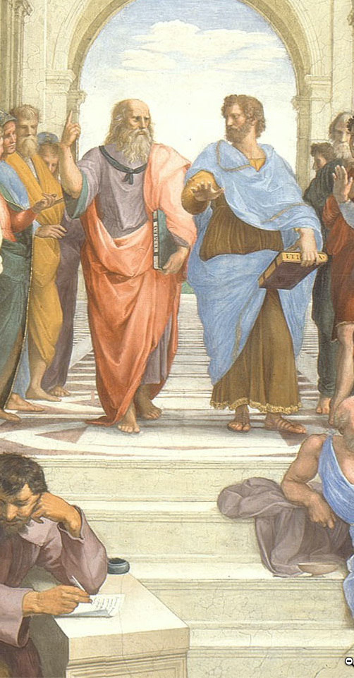
Timings: For Each Module
Aspirations for the weekly timings of the pieces of this course:
All times P[D|S]T…
0 hr: Fr 17:00: freeze all online teaching materials for the module.
Fr 17:00-Su 23:59: students do readings, take quiz, discuss (asynchronously) readings (with instructors chiming in on the threads); closes at 54 hr.
Mo 00:00-Tu 15:00: students watch & listen to slides-with-audio-lectures.
72 hr: Tu 15:30: zoom q&a session
Tu 17:00-Fr 17:00: students discuss (asynchronously) the module; closes at 168 hr.
We times various: students participate in 15 min 8 person zoom section sessions
We 17:00-Su 23:59: students do jupyter notebook problem set; closes at 199 hr;
Th 15:30: I will try to hold LeConte 4 for (socially-distanced) in-person office hours on the current module; 142.5 hr
Fr 17:00-Su 23:59: students provide feedback to instructors; closes at 199 hr.
Mo 00:00-Tu 23:59: instructors grade & assess discussion threads, zoom participation, and jupyter notebooks; closes at 271 hr.
Next Fr 12:00-23:59: students review module
Four weeks later Fr 12:00-23:59: students re-review module
Question: Where in this staggered process are things likely to go wrong?
1:00 audio
Notes:
We have a complicated proposed schedule for the various activities—that are twelve in number—that we think will make up the typical module-week. But we reserve the right to make on-the-fly adjustments over the course of the semester. We want to do what works as far as education is concerned. We want to drop what isn’t working. We figure that we have a right to ten and only ten hours of your attention and effort each week. And we want to use those ten hours a week that you are going to give us well.
One more thing to note: we are, each week, going to also look back—review briefly what we did last week, and review in greater depth what we did four weeks ago. Plus there will be the end-of-semester review process. Reminding your brain that, yes, this is important for you to remember and make new connections mentally even if you have not seen it for a while—that kind of structured repetition is very important if your learning is to be more than evanescent.
And I want you to—immediately—email to us where you think something is likely to go wrong with this chain of activities, as far as its assisting your learning is concerned. And we want to be emailed as soon as something does go wrong.

Slide 7
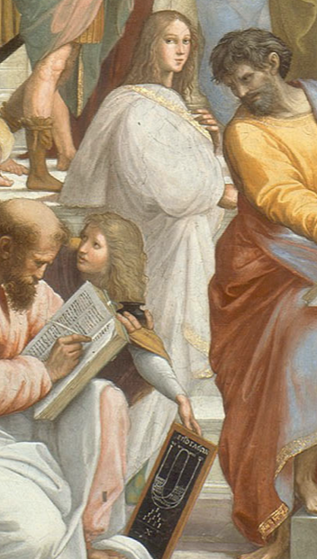
Timings: For the Semester
Notes on the timing of the semester:
First as-class-begins module online materials frozen Fr Aug 21
As-class-begins (optional, recorded) zoom q&a session Tu Aug 25
First required class zoom sessions We Aug 26
Last class day: Fr Dec 4—15 full weeks
RRR week: Fr Dec 4-Fr Dec 11
Final papers due: Fr Dec 18
Question: What else should we be asking people to do, in addition to weekly participation in the threaded discussions, weekly problem sets, & a final paper?
1:15 audio
Notes:
For the semester as a whole, you can begin the first “As Class Begins…” module on Fr Aug 25: we commit to freezing the materials in their final state then. The first of the required (to listen to; not necessarily to attend live—people’s schedules are going to get very complicated very quickly) zoom q&a session will be Tu Aug 25 15:30 PDT; zoom URL: TBA. The last class day will be Fr Dec 4. That gives us 15 full weeks—15 full modules. Plus then there will be our RRR week review. Plus then there will be our final paper.
Now here is a question: Where should we be working you harder? What else should we be asking people to do—in addition to weekly participation in the threaded discussions, weekly problem sets, & a final paper—to make this semester educationally worthwhile for you? Answers and suggestions in email to delong@econ.berkeley.edu please, with “Econ 115 Extra” as the subject line…

Slide 8
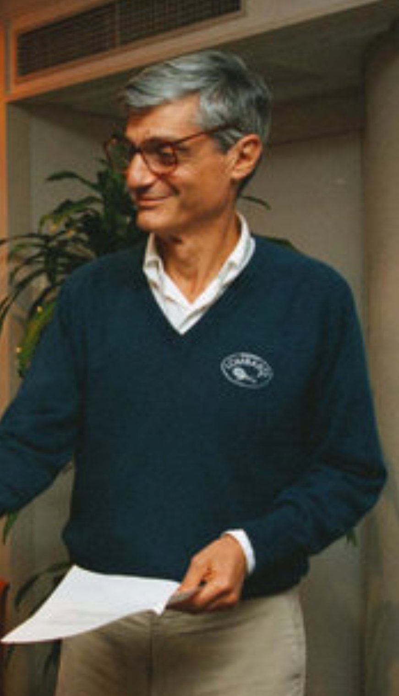
Bob Rubin’s Question
Something I have always found very useful:
Ever since I first heard it back in 1993:
What, at the end of the semester, will we wish we had done today?
Proposed answers:
I will need to hear three at the start of the zoom q&a session…
1:00 audio
Notes:
And one more thing. More than 25 years ago I learned how useful it is to ask Bob Rubin’s Question—I hope you can hear the capital “Q” in question, because it is very important—named after the former Treasury Secretary, NEC Director, and Goldman-Sachs co-head. It is very useful to ask. It is this: What, at the end of the semester, will we wish we had done today?
I will need to hear three proposed answers, at least, at the start of the zoom q&a session. For if you put yourself in your future shoes and look back at what was left undone with regret, and then if you take action, you have the greatest chance of avoiding the situations that you would later regret by taking preemptive action.
I very much want to know now what my regrets might be come December, so I can take action immediately, and so avoid them.
Please help.

Slide 9
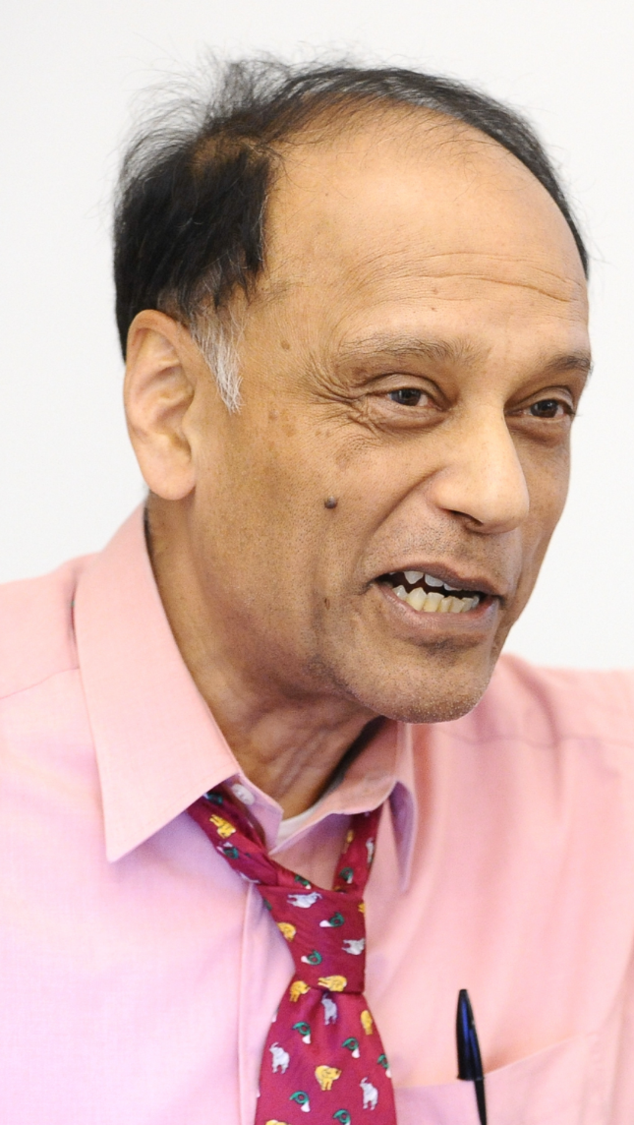
Lecture: Dasgupta on Doing Economics
Why would one want to “think like an economist”?:
What is “thinking like an economist”?:
Cost-benefit
Opportunity cost
System equilibrium
Marginality
This turns out to be useful for thinking about the economy:
(Other things too: but mostly the economy)
——
Sir Partha Sarathi Dasgupta, FRS, FBA (born 17 November 1942) is Frank Ramsey Professor Emeritus of Economics at the University of Cambridge, Fellow of St John's College, Cambridge, and Visiting Professor at the New College of the Humanities, London. He was born in Dhaka, present-day Bangladesh
2:45 audio; 6:15 of audio in this slide group
Notes:
As I already said, this is not just a history course, but an economic history course. (And this is not just an economics course, but an economic history course.) In the next module we will get into what it means to take a historical view of a subject or a situation. In this module we are looking into what it means to take an economic view. Hence we had you read Dasgupta—to remind those of you have forgotten Econ 1 what economics is as a way of thought, and to reinforce in all of you your grasp of economics by providing you with what Partha Dasgupta thinks economics is for.
Dasgupta provides a non-standard introduction. Your standard introduction would set out perhaps four fundamental principles—for example, that (i) people have likes and dislikes, and thus that decisions and situations have, for the people involved, both benefits and costs; (ii) even things that seem unmixed blessings have costs—opportunity costs—for choosing to do good thing X often means that you are giving up the opportunity to do good thing Y; (iii) people’s actions interact because people are interdependent, often the vector sum of their actions and interactions will be a result that nobody intended to bring about or perhaps even wished to see, and that societies will fall into patterns of activity that reproduce themselves in the sense of providing nobody with an incentive to do anything differently—reach a system equilibrium—and (iv) that the most important individual decisions in determining the ultimate societal outcome will be the marginal decisions, the decisions made by the people who could have most easily and straightforwardly chosen otherwise.
It would then apply these principles and teach you to do things like calculate equilibrium quantities produced and sold and prices charged in the market for some good or service.
Partha Dasgupta takes a different view. He asks a game theorist’s question: how do people fall into the patterns of interaction and exchange they do? And what makes those patterns especially productive or unproductive? In so doing he attempts to model “thinking like an economist”? And he hopes that readers, by watching and following his thoughts, will be taught an answer to the question: why would one want to “think like an economist”?:
You should also think about why this economic way of thinking is particularly useful in thinking about the economy. A hint: there is an old line about the difference between economics and sociology that goes like this: economics is all about how people make choices, and sociology is about how people do not have any important choices to make.
And think about what kinds of things an economic view is likely to see especially clearly. And think about what kinds of things an economic view is likely to fail to see at all.
——
Sir Partha Sarathi Dasgupta, FRS, FBA (born 17 November 1942) is Frank Ramsey Professor Emeritus of Economics at the University of Cambridge, Fellow of St John's College, Cambridge, and Visiting Professor at the New College of the Humanities, London. He was born in Dhaka, present-day Bangladesh

Slide 10
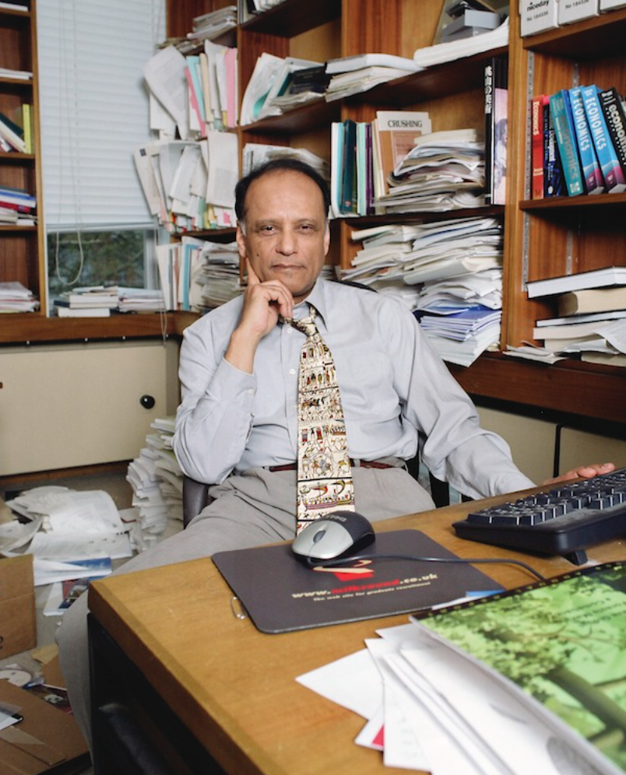
What Is the Economy?
And why is thinking like an economist the best way to analyze it?:
These are the questions Dasgupta sets out to answer by example in his book
It is a game theorist’s introduction to economics
The book won’t teach you how to calculate price and quantity changes in response to demand shocks.
The book will teach you why figuring out price and quantity changes is a worthwhile thing to do.
This is worth getting into your frontal brain lobes:
We are going to spend the semester studying the growth of the human economy
And we are going to do so by thinking like economists.
Anthology intelligence; division of labor, mechanism design; societal calculating machine
2:45 audio
Notes:
This book definitely will not teach you how to calculate price and quantity changes in response to demand shocks. That is not Dasgupta’s purpose. This book will, hopefully, teach you why figuring out price and quantity changes is a worthwhile thing to do.
This is worth getting into your frontal brain lobes, for we are going to spend the semester studying the growth of the human economy, and we are going to do so by thinking like economists.
Partha Dasgupta does model thinking like an economist: he focuses on what is going on at the margin, he looks at costs and benefits, he considers opportunity costs, and most of all he thinks in general equilibrium—how a society reaches situations in which patterns of interaction are stable, what those patterns are, and behind that the game theoretic foundations of what makes those patterns of interaction productive and unproductive.
Dasgupta's observations on the nature and causes of the wealth of nations are, I think, usefully thrown into four bins: anthology intelligence, division of labor, mechanism design, and societal calculating machines.
Because we can talk and write, we are an anthology intelligence: your brain is of use to me and my brain is of use to you, and what one of us knows or learns can be very quickly disseminated to the human race as a whole. This intellectual force multiplier makes us really smart—much smarter than any one of us could be if they had to reason things out from first principles and observations. But in order for human society to work, we need to build a system in which people are incentivized to share information rather than to transmit misinformation.
One of the things our smartness as an anthology intelligence has uncovered is the huge benefits of the division of labor: if we each specialize and each do a piece of the job, we can massively magnify our productivity. But, once again, something has to happen for society to work: we need to build into it systems in which people are incentivized to cooperate productively, rather than to steal or to hold up others.
These two lead us to the ideas of mechanism design: what societal mechanisms have we built so that we can trust each other? And how well do these mechanisms work—at what scale can we trust each other? And how can we set up a process for designing better societal mechanisms?
These thoughts lead to one of the punchlines: a properly-designed and properly-regulated market economy is an extraordinarily useful societal calculating machine for telling us what we need to do to develop knowledge, spread knowledge, and cooperate to productively use knowledge. An ill-designed or improperly-regulated market economy? Not so much.

Slide 11
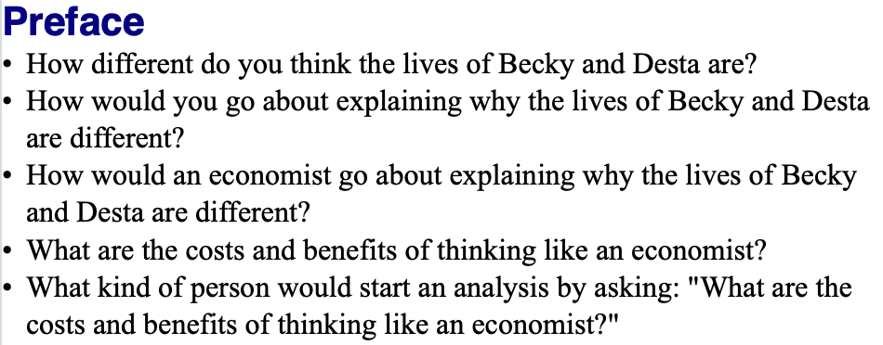
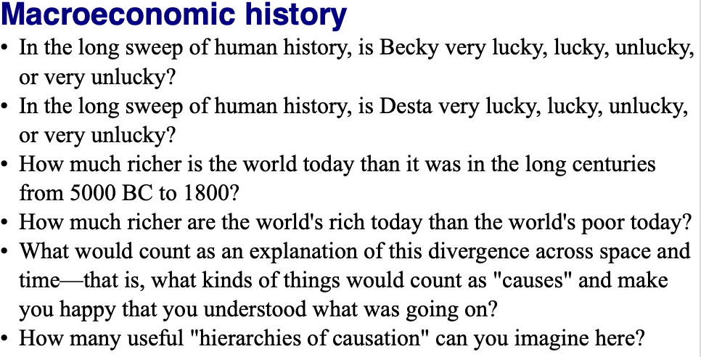
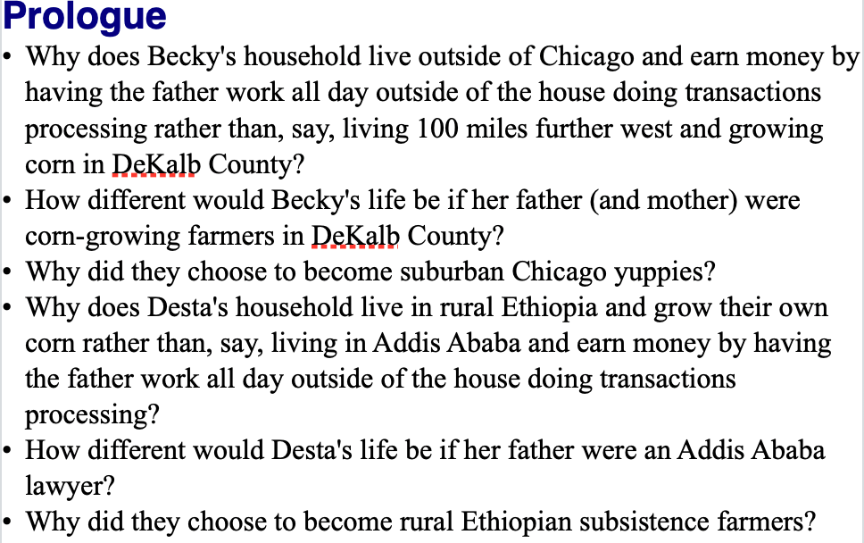
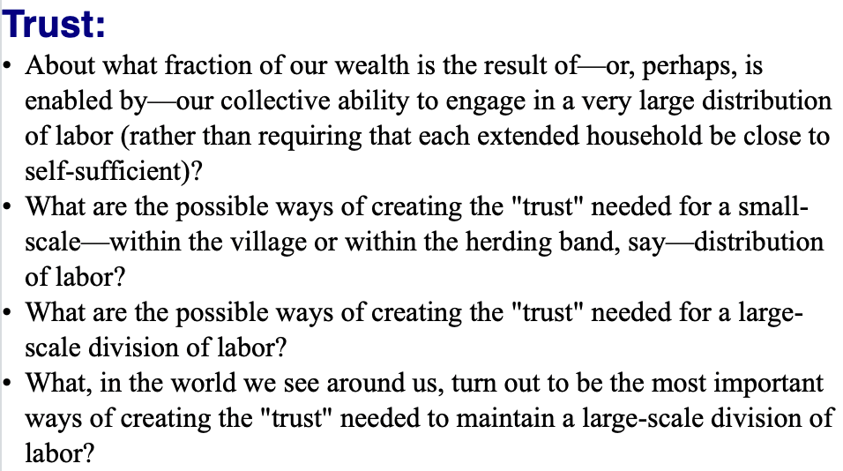
Questions
0:45 audio
Notes:
We have a number of discussion questions on Dasgupta’s little book—from 3 to 7 per chapter. Indeed, we could teach a whole course on this little book. It would be fun to do. (We would, however, have to add auxiliary readings.)
As you page through and read this and the following two slides, see how many of these questions you can successfully answer to your satisfaction off the cuff. That is a good index of the extent to which you are already engaging in “active reading”.
If your scores are low, I would advise you to think hard about what you need to do to retool how you read books, at least the books you wish to obtain some form of deep and durable knowledge from.

Slide 12
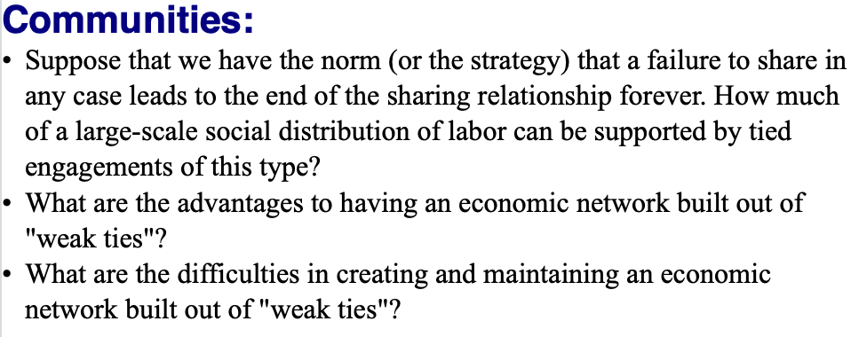
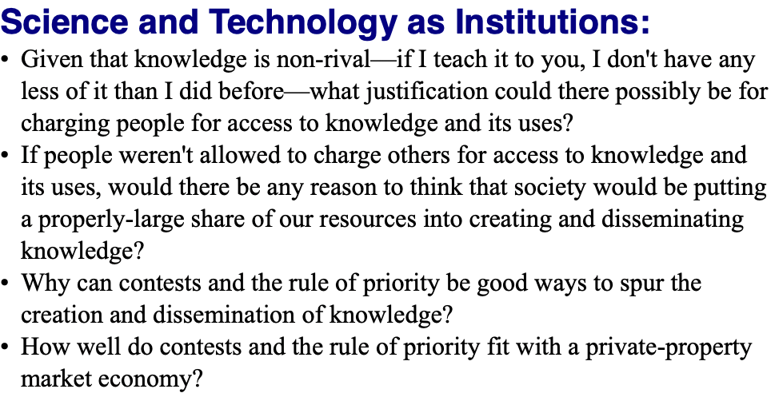
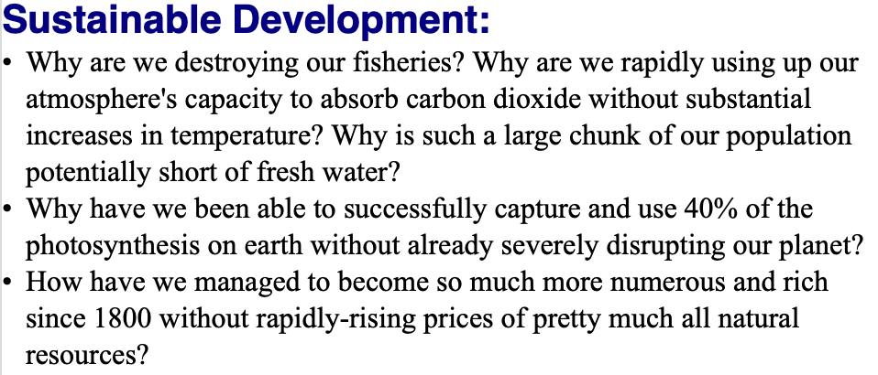
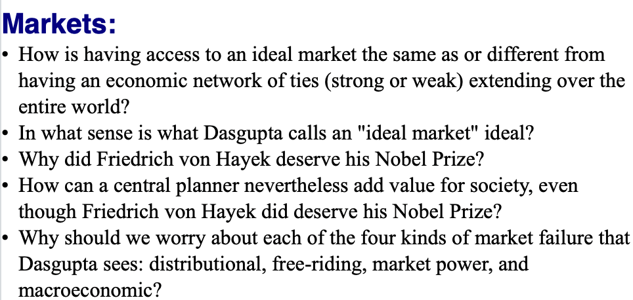
Questions II
0:00 audio

Slide 13
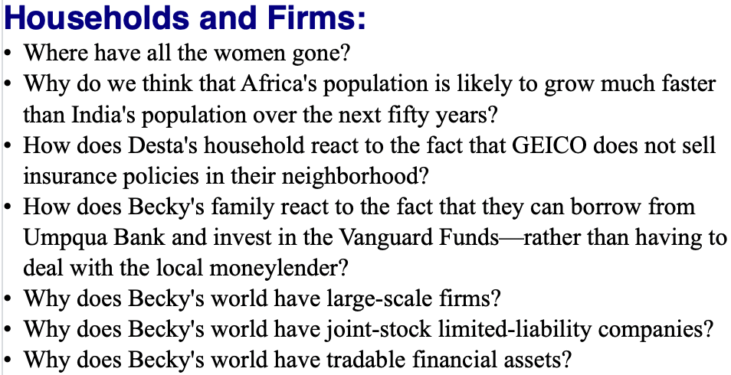
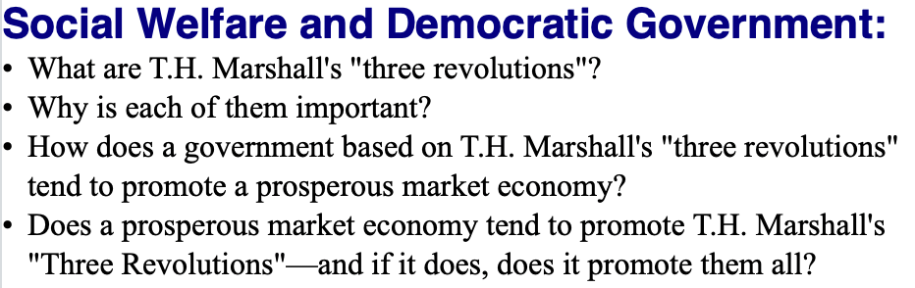
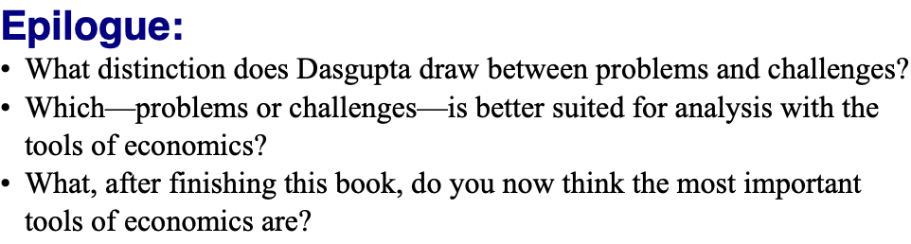
Questions III
0:00 audio

Slide 14

Lecture: Logistics
Syllabus & course policies:
In the usual bCourses place: <https://bcourses.berkeley.edu/courses/1493152/assignments/syllabus>
Required readings for the course:
Principally: J. Bradford DeLong (2020): Slouching Towards Utopia?: An Economic History of the Long 20th Century
And also: Partha Dasgupta (2007): Economics: A Very Short Introduction <https://delong.typepad.com/files/dasgupta-economics.pdf>
Barry Eichengreen (2008): Globalizing Capital: A Short History of the World Monetary System <https://delong.typepad.com/files/eichengreen-globalizing.pdf>
Robert Skidelsky (2010): Keynes: A Very Short Introduction <https://delong.typepad.com/files/skidelsky-keynes.pdf>
Robert Allen (2011): Global Economic History: A Very Short Introduction <https://delong.typepad.com/files/allen-geh.pdf> <https://www.icloud.com/pages/0jK0cjqqw-D4wRayNOo87pLYw>
Plus: Andy Matuschak (2019): Why Books Don’t Work
Grading:
Quizes: 0
Discussion threads: 30 x 2 = 60 (0, 1, 2, 3)
Problem sets: 15 x 4 = 60 (0, 1, 2, 4, 5)
Zoom breakout & other participation: 20
Final paper: 60
UNWRITTEN
Notes:
As to the logistics of this course… They are standard: the syllabus and course policies are in their usual bCourses place; our course number for bCourses is 1493152. You are responsible for reading and knowing the syllabus and course policies.
The principal required reading for the course is the draft of my 20th century economic history book, which I am distributing to you.
That is not the only required book, however. We require you—as class begins—to read Partha Dasgupta’s Economics: A Very Short Introduction as a warmup exercise: it is not a substitute for but rather a complement to Econ 1, and it is meant to remind you of economics as a discipline and get your thoughts moving as to what a history course like this that is an economic history course is likely both to see clearly and not see at all as we look at world history in the 20th century.
We require you—as class begins—to read Robert Allen’s Global Economic History: A Very Short Introduction as a cooldown exercise and as a review. Allen has a somewhat different take on the world economy in the 20th century than I do. Reading him will: (a) provide a critique of my interpretation that you may find useful, (b) remind you of my interpretation, especially where it differs from his, and so aid in active learning, and (c) possibly strike sparks for questions you might investigate as you go about researching for your final papers.
In between, we have Barry Eichengreen (2008): Globalizing Capital: A Short History of the World Monetary System, which we will read throughout the course. The international monetary system is the nervous system of the world economy. Its functions and dysfunctions are key. Barry provides a lot more background into how it functioned in different eras and thus how it fed into the rest of world economic history than I do. In between, we also have Robert Skidelsky (2010): Keynes: A Very Short Introduction. It is said that the history of the fall of the Roman Republic in the -100s is, given our source limitations, essentially the biography of the Roman consul and politician Marcus Tullius Cicero. A huge chunk of 20th century global economic history is the biography of John Maynard Keynes and his ideas. And Skidelsky is a brilliant writer: truly a pleasure to read or so I find him.
Plus we will assign a number of articles—the first of which, Andy Matuschak: Why Books Don’t Work, you should have already read before you got to this lecture.
A note on grading. We will bump up the grades of people whose contributions to synchronous discussions make us think that they got the shaft in the formal point-attribution grading process—that is what the 20 “participation” points are. Quizzes are ungraded: they are supposed to be low stakes exercises. Otherwise, we will split points between asynchronous web discussions, problem sets, and the final paper 1/3-1/3/-1/3.
Contributions to each of the 30 discussion threads will be graded on a 0-2 scale: 0 means that you did not complete the assignment before it closed; 1 means that in our view you simply phoned in your contribution, and did not make an effort; 2 means that you attempted to make a serious contribution to the discussion; 3 we reserve for someone whose contribution genuinely taught us something.
The 15 problem sets will be graded on a 0-4 scale. 0 means that no assignment was submitted or that it was submitted more than 48 hrs after the assignment closed; 1 means that the assignment was submitted up to 48 hrs late; 2 means that the assignment was phoned in, with major components not seriously attempted; 3 means that you attempted all the major pieces but did not successfully complete some important aspects; 4 means that you successfully completed the problem set; 5 means that your problem set was sufficiently ingenious and excellent that it taught us, the instructors, something.

